Slide 1
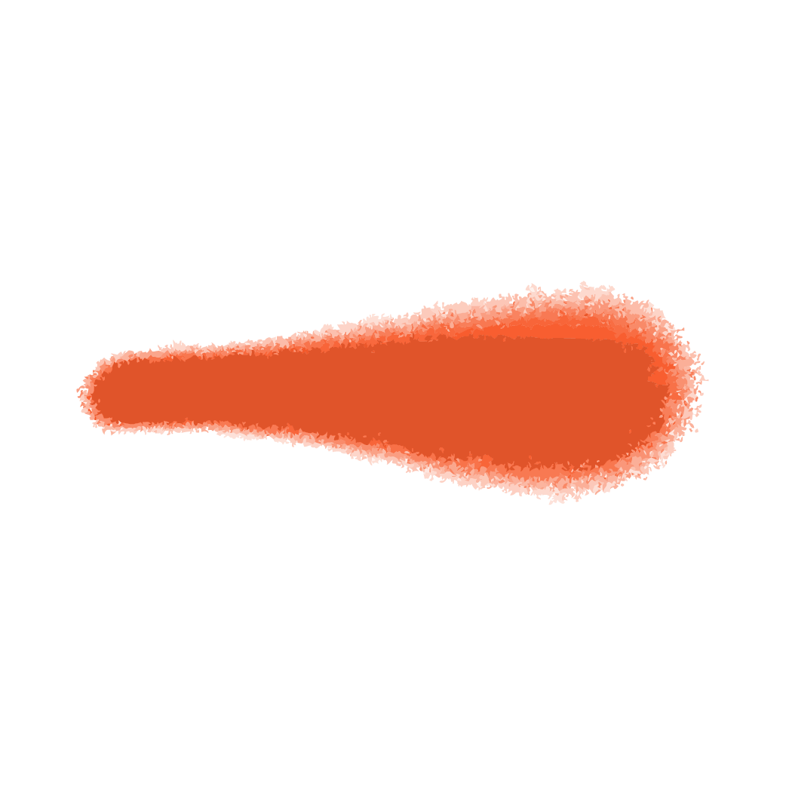
How K-D Tree be used in KNN

Slide 2

THEORY

Slide 3
K-D Tree (k-dimensional tree)
Bisecting structure
Each branch point is the median in some dimension
One set of descendants are to one side, and one to the other
Cycle the dimensions

Slide 4

KD Tree Construction
Median finding is expensive :
• O(N) or O(N log N)
• Sometimes a random subset is sorted and used to serve as splitting planes, and the rest are just fitted in there
• Lose balance guarantees (necessary for strict complexity proofs for some operations), but faster to construct
• Often balanced in practice

Slide 5
K Nearest Neighbor Search on a KD Tree
For Each Point:
• Start at the root
• Traverse the Tree to the section where the new point belongs
• Find the leaf; store it as the first element in the “Best” queue
• Traverse upward, and for each node;
• Put it at the proper point of the “Best” queue
• Check if there could be yet better points on the other side:
• Fit a sphere around the point of the same radius as distance to last element in “Best” queue
• See if that sphere goes over the splitting plane associated with the considered branch point
• If there could be, go down again on the other side. Otherwise, go up another level

Slide 6
K-D Tree example
Building a K-D Tree from training data :
Pick random dimension - find median – split data – repeat

Slide 7
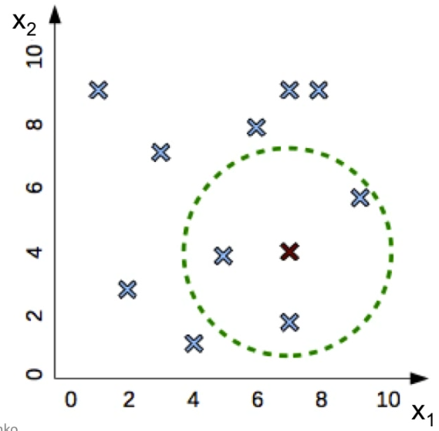
Data set : (1,9) , (2,3) , (4,1) , (3,7) , (5,4) , (6,8) , (7,2) , (8,8) , (7,9) , (9,6)

Slide 8
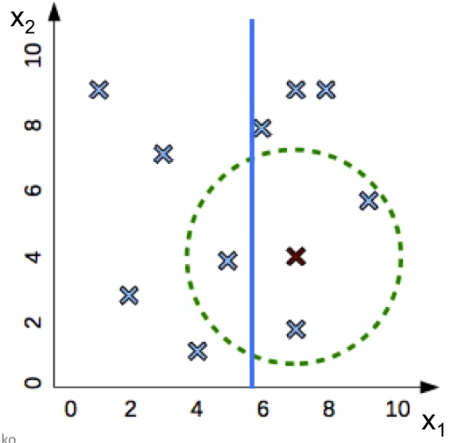
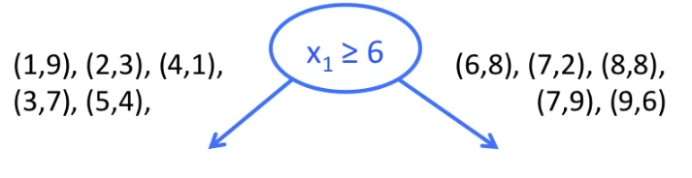

Slide 9
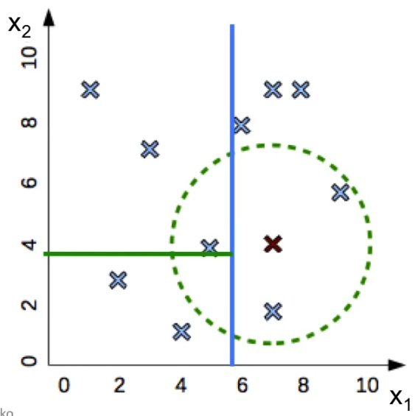
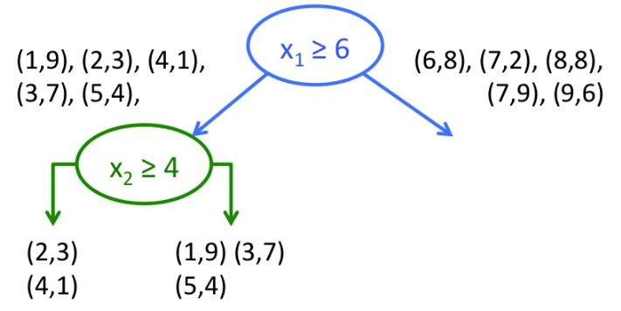

Slide 10
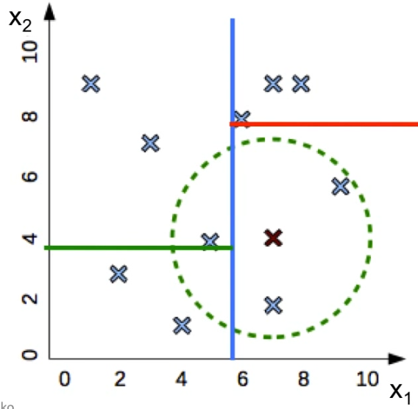
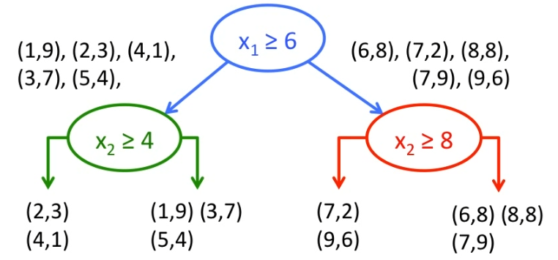

Slide 11
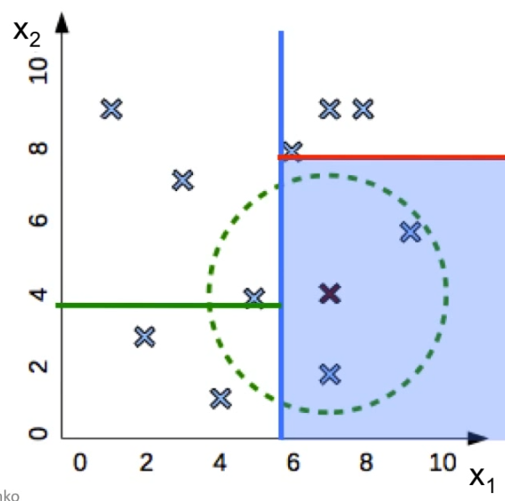
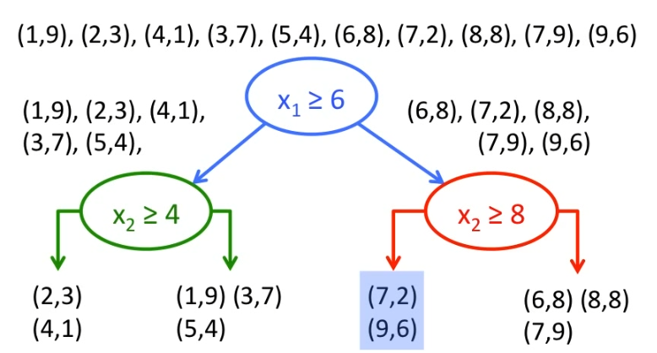
Find NNs for new point (7,4)
Find region containing (7,4)
Compare to all points in region

Slide 12
Weighted KNN

Slide 13
• Weighted KNN is a modified version of the KNN algorithm. If you don't know about KNN algorithm, then first you should understand that before learning weighted KNN • So, One of the many issues that affect the performance of the KNN algorithm is the choice of the hyperparameter k. If k is too small, the algorithm would be more sensitive to data points which are outliers. If the value of k is too large, then the neighbourhood may include too many points from other classes.

Slide 14
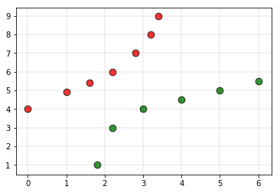
Consider the following training set
The red labels indicate the class “Red” points and the green labels indicate class “Green” points.

Slide 15
To overcome this disadvantage, weighted kNN is used.
In weighted kNN, the nearest k points are assigned a weight. The intuition behind weighted KNN is to give more weight to the points which are nearby and less weight to the points which are farther away...
The simple function which is used is the inverse distance function which implies that as the distance increases weight decreases and as the distance decreases, weight increases

Slide 16
Radius Neighbors Classifier Presentation Differences from Neighbors Classifier

Slide 17
Radius Neighbors Classifier
Radius Neighbors is a classification machine learning algorithm.
It is based on the k-nearest neighbors algorithm, or kNN. kNN involves taking the entire training dataset and storing it. Then, at prediction time, the k-closest examples in the training dataset are located for each new example for which we want to predict. The mode (most common value) class label from the k neighbors is then assigned to the new example.
The Radius Neighbors Classifier is similar in that training involves storing the entire training dataset. The way that the training dataset is used during prediction is different.

Slide 18
Radius Neighbors Classifier
The Radius Neighbors Classifier is similar in that training involves storing the entire training dataset. The way that the training dataset is used during prediction is different.
The radius is defined in the feature space and generally assumes that the input variables are numeric and scaled to the range 0-1, e.g. normalized.
Instead of locating the k-neighbors, the Radius Neighbors Classifier locates all examples in the training dataset that are within a given radius of the new example. The radius neighbors are then used to make a prediction for the new example.
The radius-based approach to locating neighbors is appropriate for those datasets where it is desirable for the contribution of neighbors to be proportional to the density of examples in the feature space.

Slide 19
Radius Neighbors Classifier
Given a fixed radius, dense regions of the feature space will contribute more information and sparse regions will contribute less information. It is this latter case that is most desirable and it prevents examples very far in feature space from the new example from contributing to the prediction.
As such, the Radius Neighbors Classifier may be more appropriate for prediction problems where there are sparse regions of the feature space.
Given that the radius is fixed in all dimensions of the feature space, it will become less effective as the number of input features is increased, which causes examples in the feature space to spread further and further apart. This property is referred to as the curse of dimensionality.

Slide 20
Difference of radius neighbor compared to k-NN
An alternative to k-nearest neighbor wherein the nearest neighbor is determined by a radius hyper-parameter

